Slide 1
Object Oriented Programming using Python - FINAL PROJECT Prof. Rabih Neouchi
Data visualization
Team tech pandas: (Group 9)
Ayush oswal r
Siddesh iyer h
Harshitha paturi

Slide 2
Data set
For the purpose of visualization, we used a data set which is “Population-Cities.csv”
The requirements were met .

Slide 3
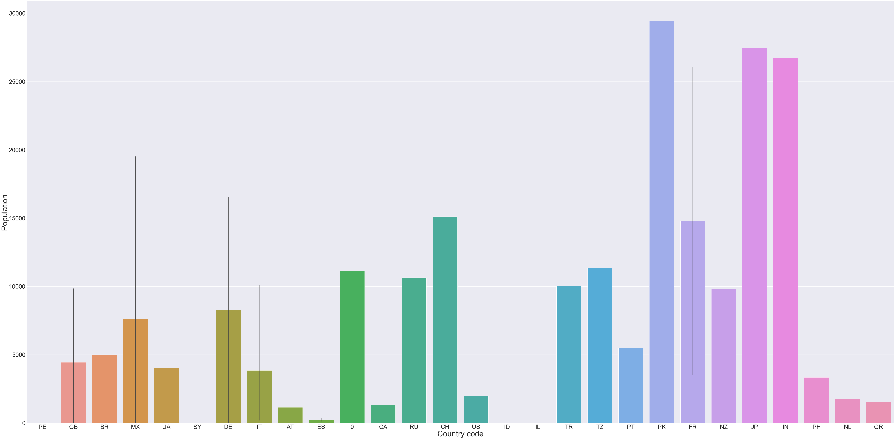
ANALYSIS : POPULATION VS COUNTRY CODE
According to the bar plot, Highly populated country is PK(Pakistan), whereas the lowest population lies in (ES)Spain and (VE) Venezuela.

Slide 4
Population range for countries
The highest average population is for Pakistan, while it also has the same max, min, first quartile and third quartile.
The countries which have more standard deviation comparatively are: Turkey, France and United Republic.

Slide 5
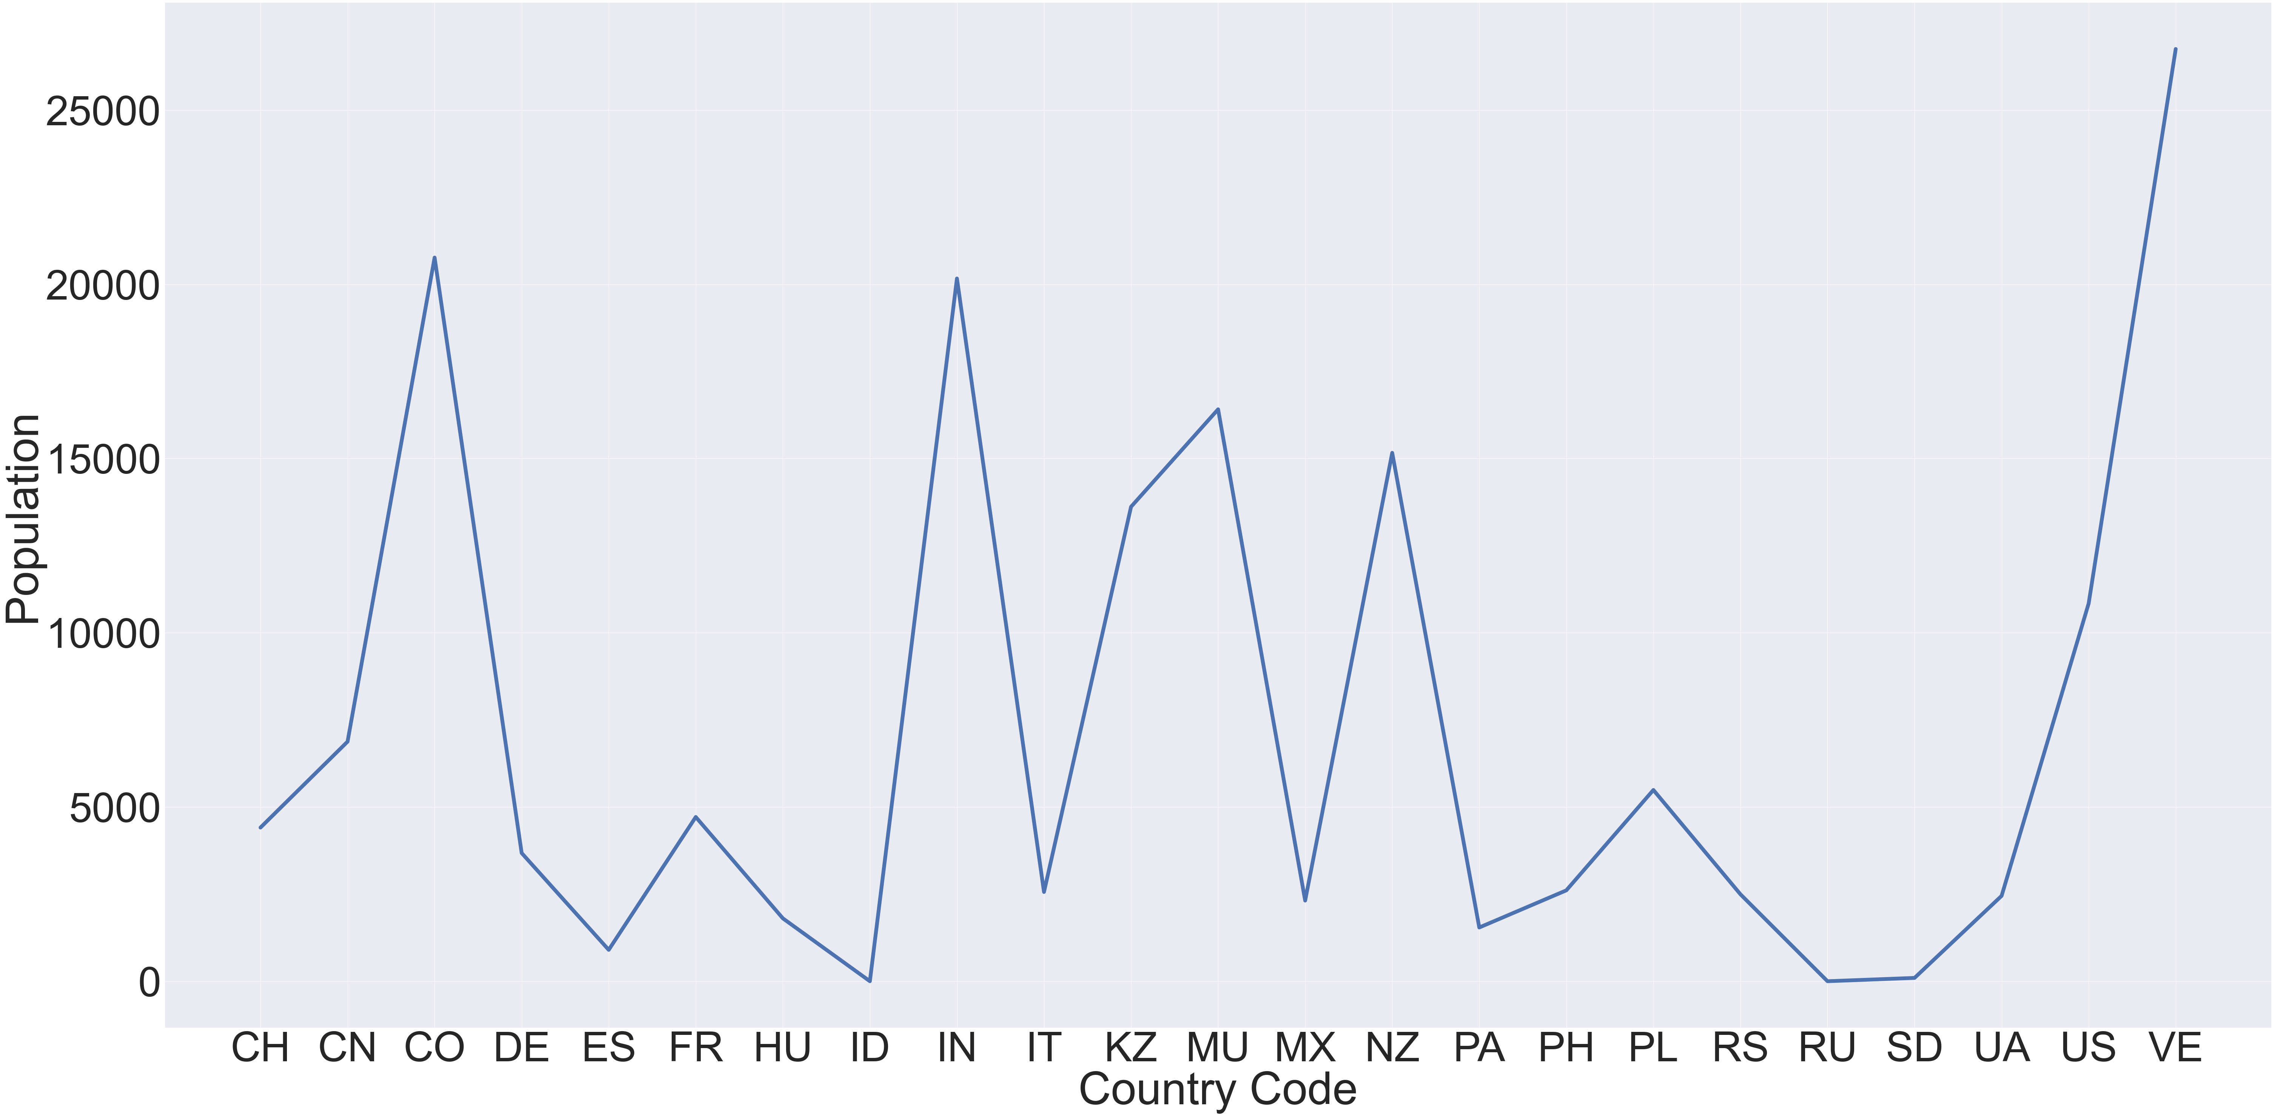
Line graph: country code vs average population
In this graph, we removed the unwanted columns and incorrect values.

Slide 6
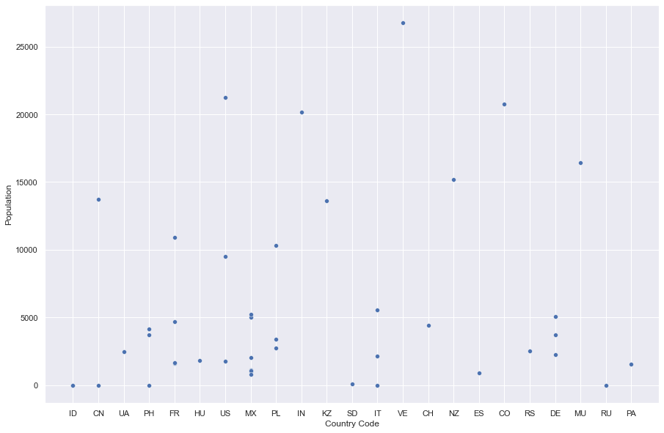
Scatter plot
The highest scattered population is for Venezuela.

Slide 7
Histogram for count
The highest count of the country in the dataset is United States.

Slide 8
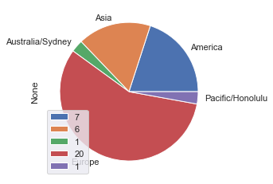
Pie-chart
The pie-chart is an analysis to check how
the population is present in each “Continent” grouping by the “Time zone”
This is from a sample of only 35 entries from the entire population.

Slide 9
Heat map
Generating a heatmap of the total population of a particular region in a particular year
Extracting the 'population year' from 'population data’
This heatmap is based on the entire population and not on the sample
This is for summarizing the entire population according to country code and year.

Slide 10
CONCLUSION
Using this dataset & creating visualizations on it, we analyzed various trends relating to the population, country & the year.
We could examine what country or city had the highest, lowest or average population in which year as well as see which continent had how many people present in that moment of time.
One additional thing we could use of is the time zone too, which helped us in breaking down the time zone ~ country relation.

